Slide 1
Project Management
The job of an IT company engaged in software development can be seen split in two parts:
Software Creation
Software Project Management
Project management involves the planning, monitoring, and control of the people, process, and events that occur as software evolves from a preliminary concept to an operational implementation.
Software project management is an umbrella activity within software engineering. It begins before any technical activity is initiated and continues throughout the deﬁnition, development, and support of computer software.

Slide 2
The four P’s
Four P’s have a substantial inﬂuence on software project management—people, product, process, and project.
People must be organized into effective teams, motivated to do high-quality software work, and coordinated to achieve effective communication.
The product requirements must be communicated from customer to developer, partitioned (decomposed) into their constituent parts, and positioned for work by the software team.
The process must be adapted to the people and the problem. A common process framework is selected, an appropriate software engineering paradigm is applied, and a set of work tasks is chosen to get the job done.
Finally, the project must be organized in a manner that enables the software team to succeed.

Slide 3
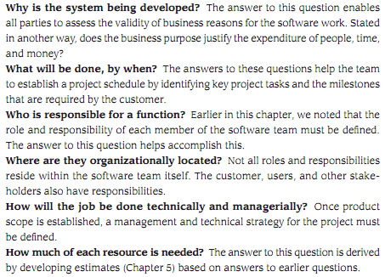
Boehm’s “W5HH” principle

Slide 4
Measurement and Metrics
Measure - quantitative indication of extent, amount, dimension, capacity, or size of some attribute of a product or process. E.g., Number of errors
Measurement - The act of determining a measure
Metric - quantitative measure of degree to which a system, component or process possesses a given attribute. -E.g., Number of errors found per person hours expended
Indicator – An indicator is a metric or combination of metrics that provide insight into the software process, a software project or the product itself.

Slide 5
Why Measure Software?
Determine the quality of the current product or process
Predict qualities of a product/process
Improve quality of a product/process.
To assess the benefits derived from new software engineering methods and tools
To form a baseline for estimation
To help justify requests for new tools or additional training

Slide 6
Metrics of Software Quality
Functionality - features of system
Usability – aesthesis, documentation
Reliability – frequency of failure, security
Performance – speed, throughput
Supportability – maintainability

Slide 7
Categories of Software Measurement
Measurements in the physical world can be categorized in two ways:
-direct measures (e.g., the length of a bolt) and
- indirect measures (e.g., the "quality" of bolts produced, measured by counting rejects).
Direct measures of the software engineering process
-include cost and effort applied.
Direct measures of the product
-include lines of code (LOC) produced, execution speed, memory size, and defects reported over some set period of time.
Indirect measures of the product
-include functionality, quality, complexity, efﬁciency, reliability, maintainability, and many other "abilities"

Slide 8
Size oriented metric : LOC
It is one of the earliest and simpler metrics for calculating the size of the computer program
It is generally used in calculating and comparing the productivity of programmers
Size oriented software metrics are derived by normalizing quality and/or productivity measures by considering the size of the software that has been produced
If a software organization maintains simple records, a table of size-oriented measures.

Slide 9
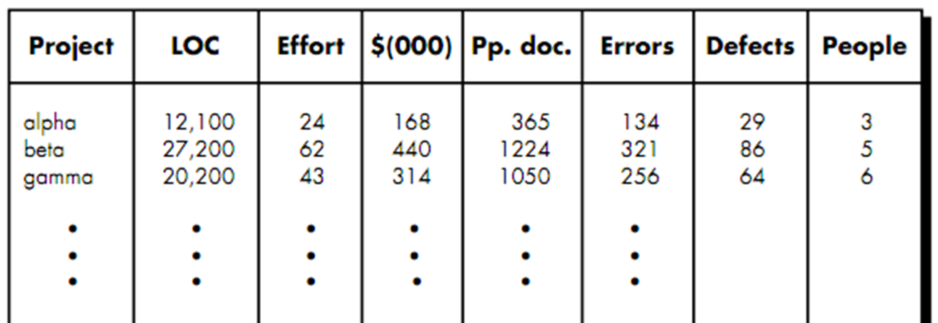
Size oriented metric : LOC

Slide 10
Size oriented metric : LOC
To develop metrics that can be assimilated with similar metrics from other projects, we choose Line of Code as our normalization value.
So, from information given in table , a set of simple size-oriented metrics can be developed for each projects:
Some examples:
-Errors per KLOC (thousand lines of code).
-Defects per KLOC.
-$ per LOC.
-Page of documentation per KLOC.
In addition, other interesting metrics can be computed:
-Errors per person-month.
-LOC per person-month.
-$ per page of documentation.

Slide 11
Problems of LOC
Although size-oriented metrics are not universally accepted as the best way to measure the process of software development, they are pretty useful.
Opponents argue that LOC measures are programming language dependent,
It characterizes only one specific view of size, namely length, it takes no account of functionality or complexity
As it is used in estimation requires a level of detail that may be difﬁcult to achieve (i.e., the planner must estimate the LOC to be produced long before analysis and design have been completed)

Slide 12
Function oriented metric: FP
Function-oriented metrics use a measure of the functionality delivered by the application as a normalization value
Using historical data, the FP metric can then be used to
(1) estimate the cost or effort required to design, code, and test the software;
(2) predict the number of errors that will be encountered during testing; and
(3) forecast the number of components and/or the number of projected source lines in the implemented system.

Slide 13
Information domain values
External Inputs: Functions related to data entering the system.
External outputs: Functions related to data exiting the system.
External Inquiries: They leads to data retrieval from system but don’t change the system.
Internal Files: Logical files maintained within the system. Log files are not included here.
External interface Files: These are logical files for other applications which are used by our system.

Slide 14
Steps In Calculating FP
1. Count the measurement parameters.
2. Assess the complexity of the values.
3. Calculate the raw FP (see next table).
4. Rate the complexity factors to produce the complexity adjustment value (CAV)
5. Calculate the adjusted FP as follows:
FP = raw FP x [0.65 + 0.01 x ∑(f_{i})]

Slide 15
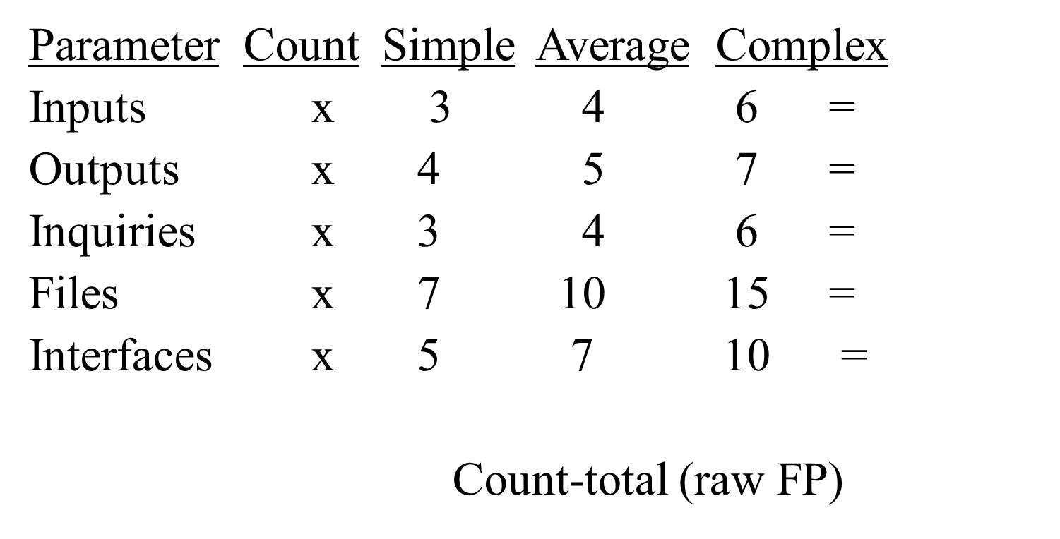
Function Point Metrics

Slide 16
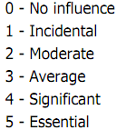
Complexity Adjustment Value (CAV)
Does the system require reliable backup and recovery?
Are data communications required?
Are there distributed processing functions?
Is performance critical?
Will the system run in an existing, heavily utilized operational environment?
Does the system require on-line data entry?
Does the on-line data entry require the input transaction to be built over multiple screens or operations?

Slide 17
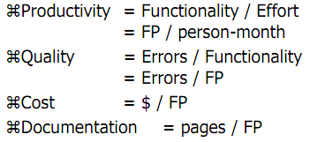
FP oriented metrics
Notes:
Q: example of FP oriented metrics

Slide 18
Reconciling LOC and FP Metrics
Relationship between LOC and FP depends upon
-The programming language that is used to implement the software
-The quality of the design
FP and LOC have been found to be relatively accurate predictors of software development effort and cost
However, a historical baseline of information must first be established
LOC and FP can be used to estimate object-oriented software projects
However, they do not provide enough granularity for the schedule and effort adjustments required in the iterations of an evolutionary or incremental process
The table on the next slide provides a rough estimate of the average LOC to one FP in various programming languages

Slide 19
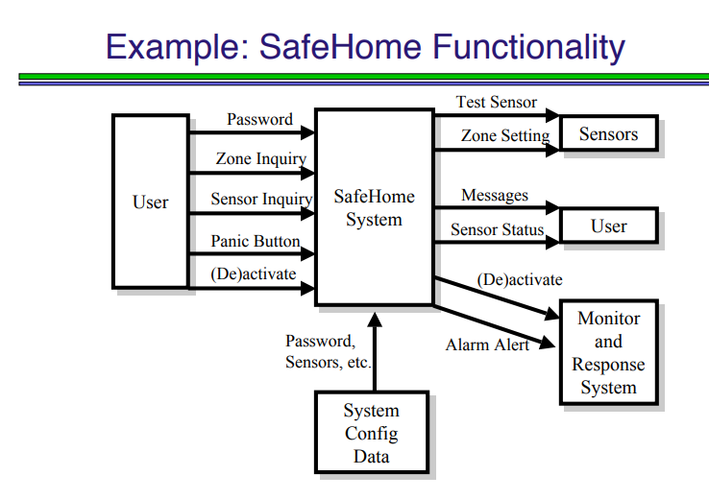

Slide 20
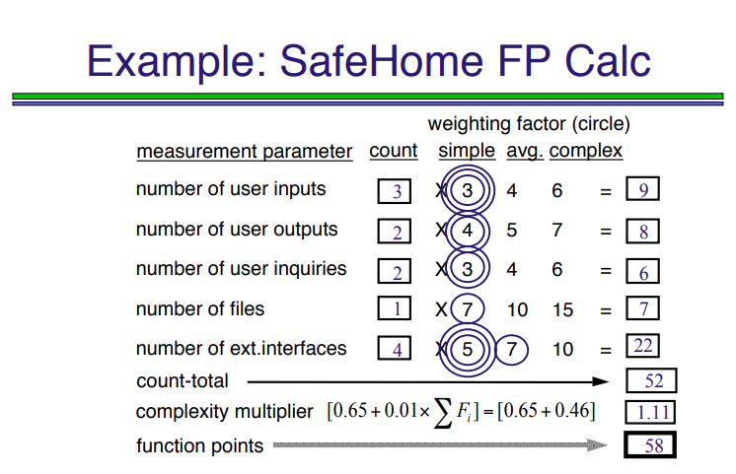

Slide 21
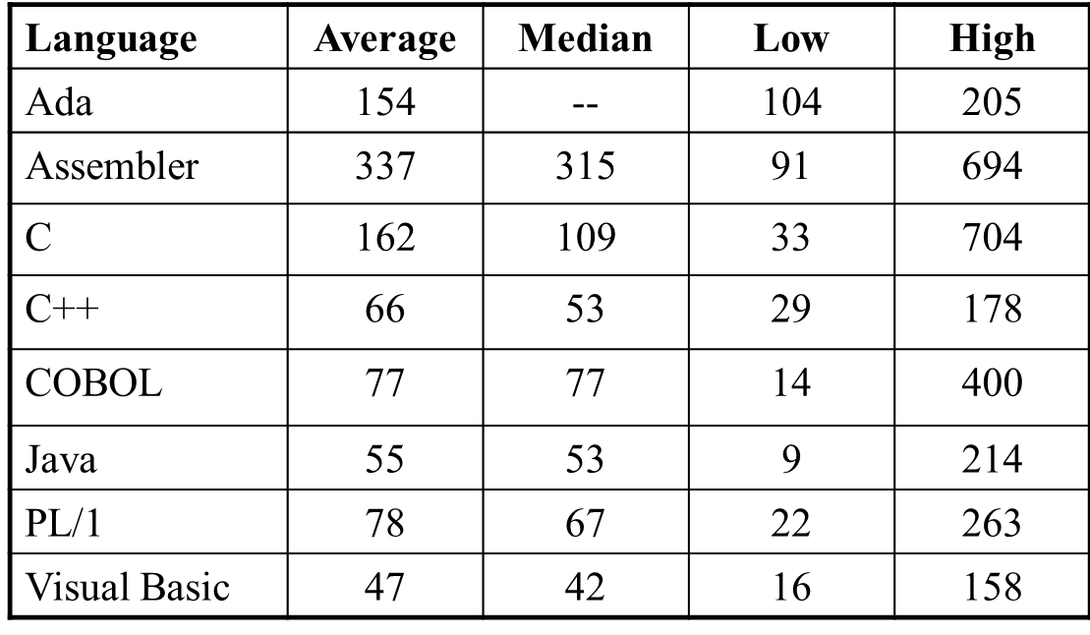
LOC Per Function Point

Slide 22
Establishing a Metrics Baseline
By establishing a metrics baseline, benefits can be obtained at the software process, product, and project levels
The same metrics can serve many masters
The baseline consists of data collected from past projects
Baseline data must have the following attributes
-Data must be reasonably accurate (guesses should be avoided)
-Data should be collected for as many projects as possible
-Measures must be consistent (e.g., a line of code must be interpreted consistently across all projects)
-Past applications should be similar to the work that is to be estimated
After data is collected and metrics are computed, the metrics should be evaluated and applied during estimation, technical work, project control, and process improvement

Slide 23
Software Metrics Baseline Process
Software
Engineering
Process
Measures
Software
Project
Data
Collection
Metrics
Metrics
Computation
Software
Product
Indicators
Metrics
Evaluation

Slide 24
Compute the function point, productivity, documentation, cost per function for the following data:
Number of user inputs = 24
Number of user outputs = 46 Number of inquiries = 8
Number of files = 4
Number of external interfaces = 2
Effort = 36.9 p-m
Technical documents = 265 pages
User documents = 122 pages
Cost = $7744/ month
Various processing complexity factors are: 4, 1, 0, 3, 3, 5, 4, 4, 3, 3, 2, 2, 4, 5.
Weighing factor: 4, 4, 6, 10, 5

Slide 25
Measurement Parameter | Count | Weighing factor
1. Number of external inputs (EI) | 24 | 4 | 96
2. Number of external outputs (EO) | 46 | 4 | 184
3. Number of external inquiries (EQ) | 8 | 6 | 48
4. Number of internal files (ILF) | 4 | 10 | 40
5. Number of external interfaces (EIF) Count-total → | 2 | 5 | 10
Total |  |  | 378
*
*
*
*
*

Slide 26
So sum of all f_{i} (i ← 1 to 14) = 4 + 1 + 0 + 3 + 5 + 4 + 4 + 3 + 3 + 2 + 2 + 4 + 5 = 43
FP = Count-total * [0.65 + 0.01 *∑(fi)]
= 378 * [0.65 + 0.01 * 43]
= 378 * [0.65 + 0.43]
= 378 * 1.08 = 408

Slide 27
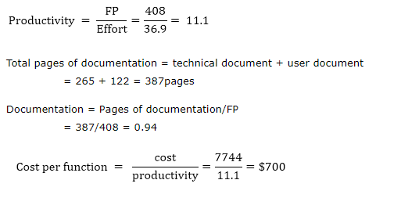

Slide 28
FP | LOC
Function Point metric is language independent. | LOC metric is dependent on language.
Function Point metric is user-oriented. | LOC metric is design-oriented.
Function Point metric is extendible to Line of Code. | It is changeable to FP (i.e, backfiring)
Function Point is used for data processing systems | LOC is used for calculating the size of the computer program
Function Point can be used to portray the project time | LOC is used for calculating and comparing the productivity of programmers.

